Slide 1
Income and Wealth
Data Fest 2
Nejma Ahmed, Janelle Guse, Addie Harsch,
Gladys Rosas, Sofia Omar, Shiona Samejima

Slide 2
Context/Introduction
AIAN communities in the United States face economic challenges and those challenges are the result of income and wealth disparities compared to the general population.
We focused primarily on hourly wages and race. Income disparities between AIAN and non-AIAN when comparing hourly salary vs. race, age vs. race and family income.
Notes:
Sofia

Slide 3
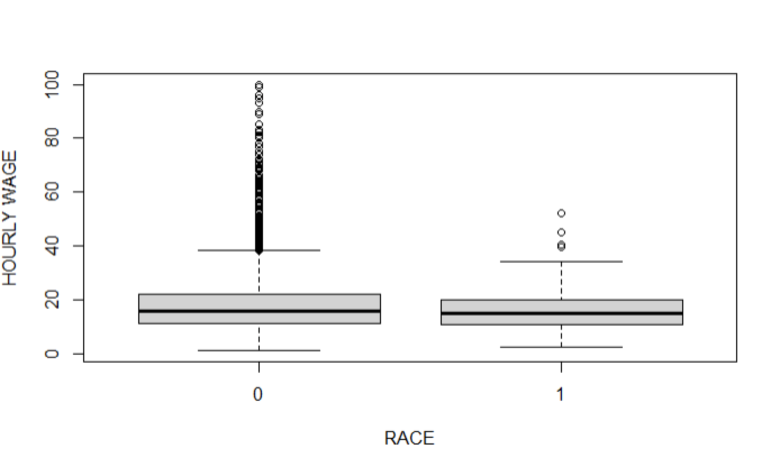
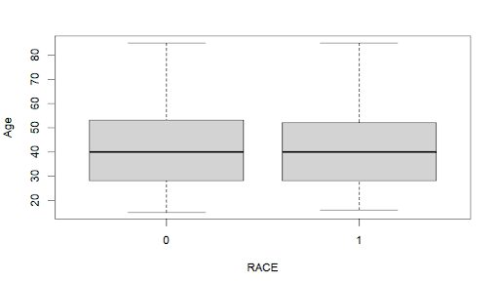
Summary/descriptive statistics
Notes:
addie

Slide 4
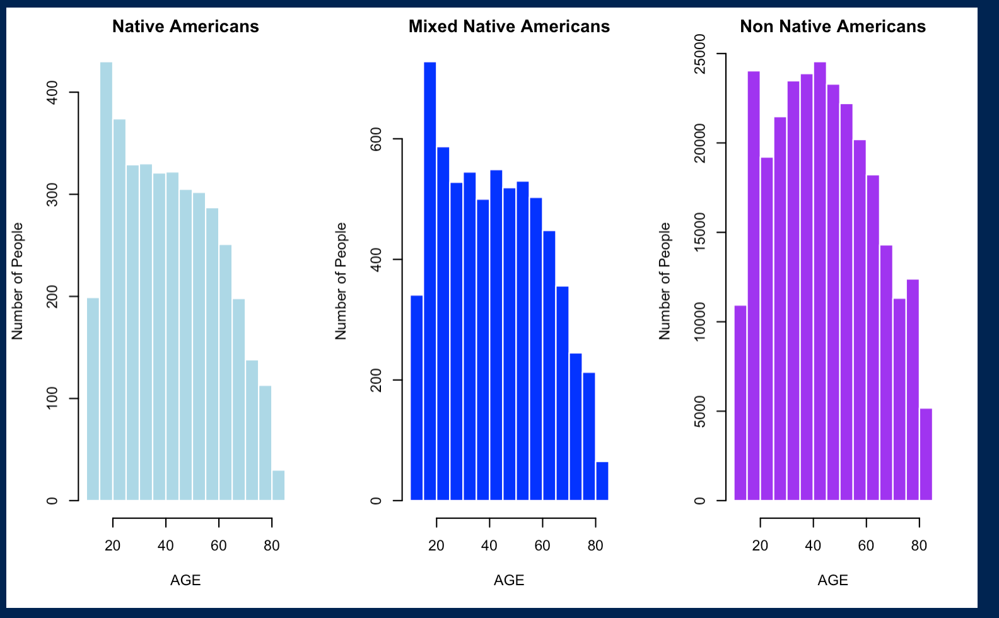
Notes:
Gladys

Slide 5
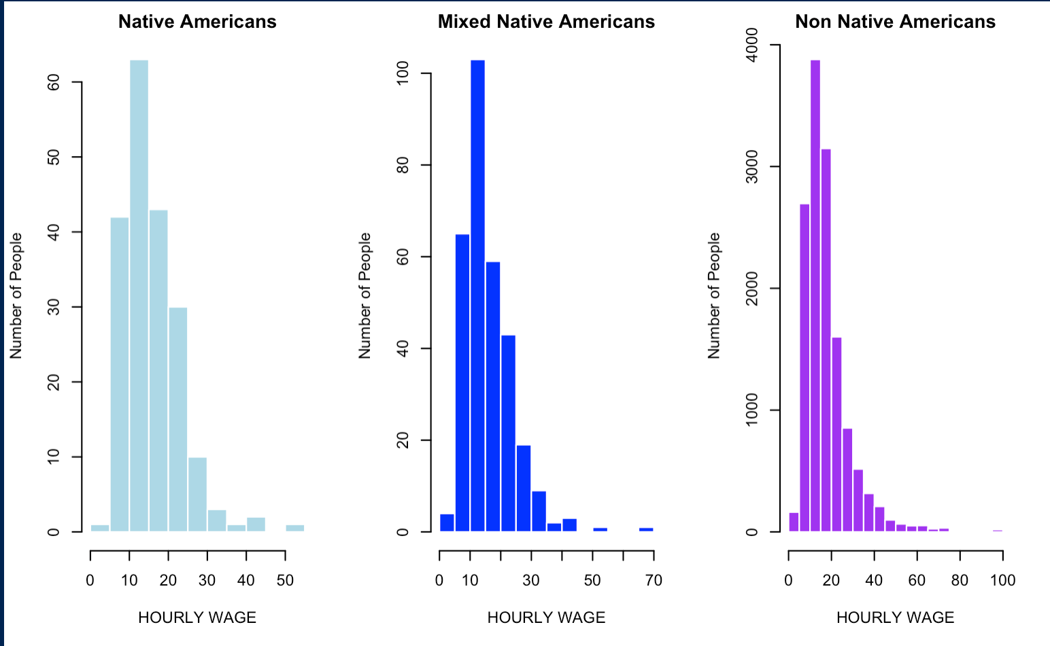
Notes:
nejma

Slide 6
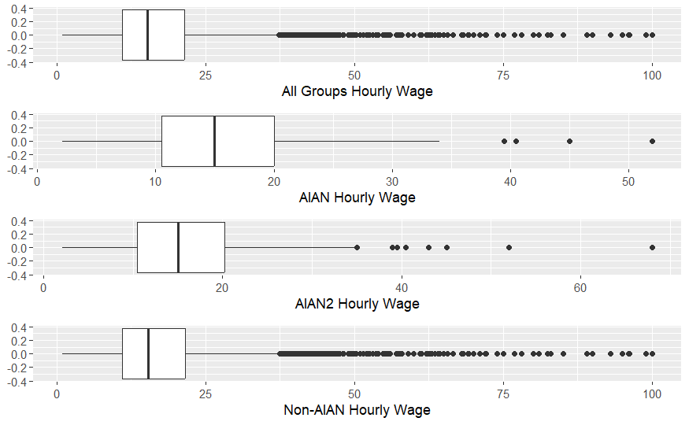
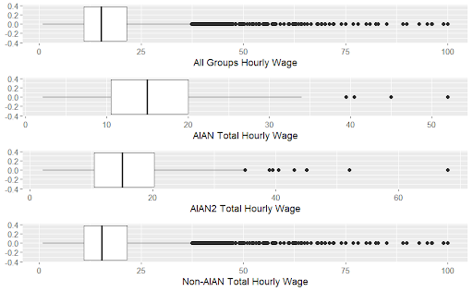
Notes:
Janelle

Slide 7
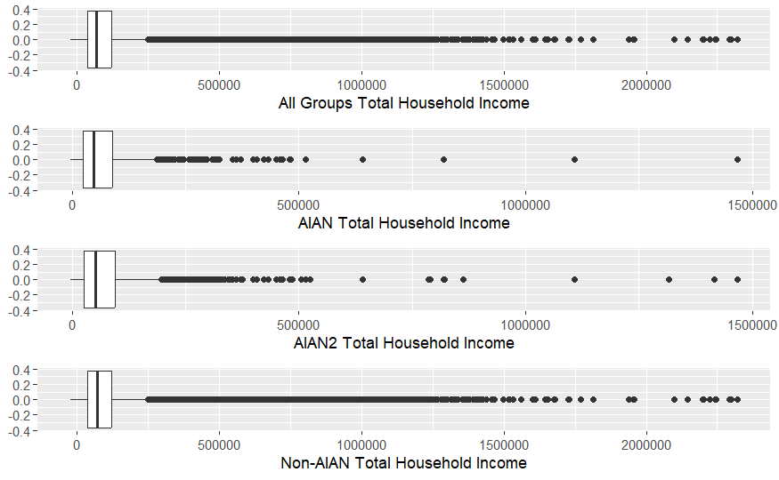
Notes:
Janelle

Slide 8
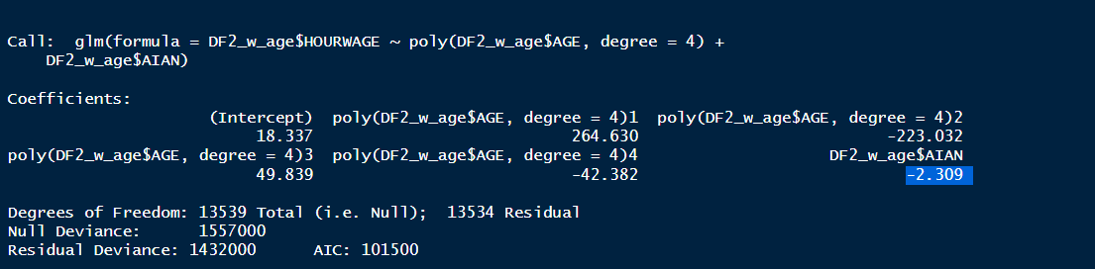
Method & Preliminary Results
Orthogonal polynomial was used to control age because younger people typically earn less.
Multicollinearity represents a high degree of linear intercorrelation between explanatory variables in a multiple regression model and leads to incorrect results of regression analyses. Multicollinearity increases likelihood of overfitting
An AIAN person, after controlling for age (younger people are supposed to make less), is associated with making $2.31 less an hour. (p-value = 0.00218) (95% C.I [0.8632416, 3.7567584]).
Notes:
Shiona

Slide 9
Policy implications/
suggestions for future research
Look into data to understand if children are contributing to household income
Compare single income households to others
Data on subsidized housing
Data on rent/mortgage and see how, for both cases, much their children contribute to the total household income
Hourly wages controlled for gender
Missing Data
Notes:
addie

